Slide 1



"Serious" B2B marketing sup port starting with webinars : Introduction to Majisemi
For those considering Majisemi for the first time
Seminars with strong customer attraction
No.1
Seminars strong in acquiring new business negotiations
No.1
Seminars chosen by IT managers
No.1
Survey by Japan Marketing Research Organization Overview: 2021 Service Comparison Impression Survey

Slide 2
Introduction
Purpose of today's meeting
For companies considering "Majisemi" for the first time, we will discuss the following topics.
Hearing about challenges in marketing
How will you utilize Majisemi?
©2018 MAJISEMI Inc.

Slide 3
Hearing
©2018 MAJISEMI Inc.

Slide 4
Hearing
Issue Identification
■ About the products you want to introduce in the seminar
・Which products/services?
・Who is the target audience (who do you want to invite to the seminar)?
・Industry, company size, department, position, etc.
※ Majisemi's areas of expertise are "IT departments, DX departments, security departments across all industries, and production/manufacturing departments in factories"
・What are the competing products?
・What are the strengths and differentiation points against competing products?
©2018 MAJISEMI Inc.

Slide 5
Hearing
Issue Identification
■ About the necessity of seminars (webinars)
・What do you consider important as a means of lead acquisition?
・Seminars (webinars)
・Website (content marketing)
・Real exhibitions
・比較サイト
・GoogleやFacebookなどへの広告
・テレアポ
・その他
■予算の状況
・リード獲得単価、アポ獲得単価
・セミナー（ウェビナー）の予算の有無、及び金額
・上記リード獲得手段の予算の割合
・予算の策定、決定時期
©2018 MAJISEMI Inc.

Slide 6
Hearing
Issue Identification
■セミナー（ウェビナー）の目的／課題
・より多くのリードを獲得したい／集客できない
・ターゲットに合ったリードを獲得したい／リードの質が悪い
・ウェビナーから商談につなげたい／商談につながらない
・ウェビナーの運営を代行してほしい／運営が大変
・まずはスモールスタートでウェビナーをやってみたい
・その他
・ウェビナーを活用した、東南アジアにおける新規顧客開拓やテストマーケティング
©2018 MAJISEMI Inc.

Slide 7
なぜ「ウェビナー」なのか？
©2018 MAJISEMI Inc.

Slide 8
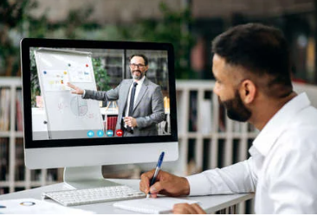

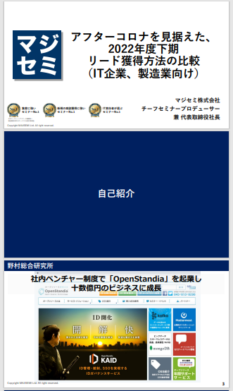
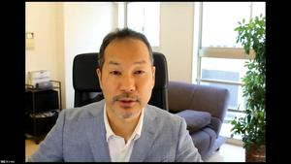
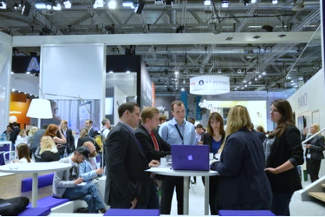
BtoBマーケティングにおけるウェビナーの役割
Webinar
as a Service
Lead acquisition
Lead Nurturing
Proposal and order
課題に
気づいてない
課題に気づき
社内で検討
製品・サービスの
候補を捜す
製品・サービスを絞って
評価・選定、稟議
課題に気づかせる
課題について深く理解させ、
解決方法を提示する
競合よりもお客様に早く接触し、課題解決をサポートする
数社～十数者程度の検討の候補に入り、２～３社の最終候補に残る
２～３社の最終候補から自社を選んでもらう
Utilization of Webinar Content
課題に気づかせる。
課題について深く理解させる。
競合よりもお客様に先に接触し、自社を知ってもらう。
When hosting a webinar,
a lot of content is generated.
● Presentation materials → White Paper
● Presentation video → YouTube, Social Media
● Presentation content → SEO articles, blogs
Webinar
Field Sales
Webサイト
Content Marketing
Webinar
Social Media Advertising
Deepen understanding of challenges.
Also provide competitive comparison information and information about our products.
For nurturing existing leads.
リアル展示会
オンラインイベント
Downloadable Materials
Field Sales
©2018 MAJISEMI Inc.

Slide 9

Email Advertising
Positioning of Webinars in Lead Acquisition
planning
Cost per Lead
Telemarketing
30,000 yen
Webinar
リアル展示会
Listing/Social Media Advertising
Visitor
14,500 JPY
Majisemi
Club
10,000 yen and up
10,000 yen
Online
Exhibition
(Large-scale Webinar)
Comparison Sites
Downloadable Materials
オンデマンド
Video distribution
5,000 yen
リアル展示会
Joint exhibition
Low
Interest
High
©2018 MAJISEMI Inc.

Slide 10
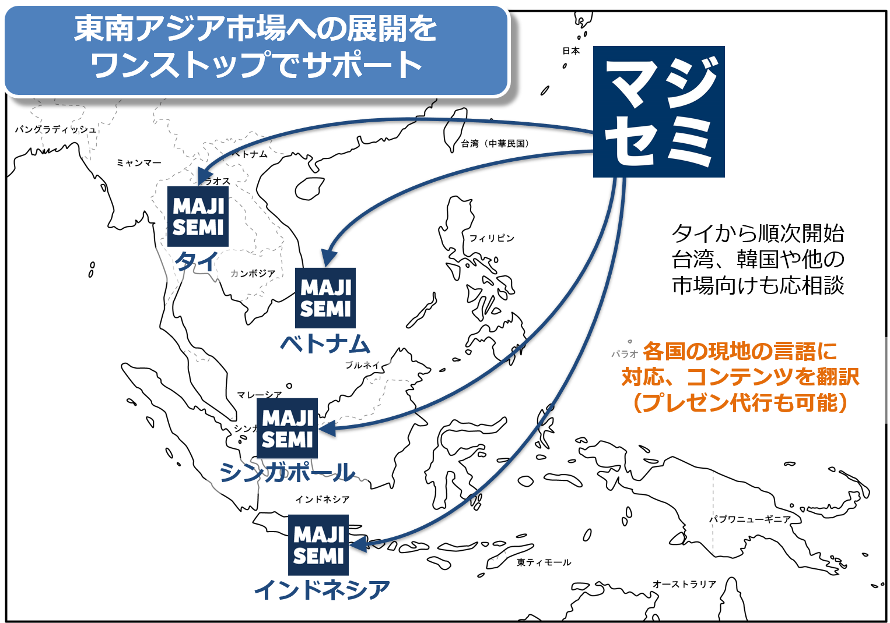
Support for expanding into Southeast Asia using webinars
planning
Webinars can be broadcasted to Southeast Asia at nearly the same cost as for Japan.
Your company only needs to prepare a presentation video (+ slides) in Japanese (or English).
Majisemi handles everything from adding local language subtitles, translating slides, to day-of broadcast.
Optional post-webinar lead follow-up and secondary use of webinars with local language support are also available.
Promoting joint exhibition at trade shows held in Southeast Asia.
©2018 MAJISEMI Inc.

Slide 11


Why start with webinars?
planning
Cold calls or direct mail without any prior connection can lead to distrust.
First, by hosting a webinar that "provides valuable information," you can establish the initial connection and
gain "trust and credibility."
Features of webinars
When emailing the entire list
Can provide an "interactive experience"
Live Q&A sessions
Demonstrations and factory tours while receiving questions and requests
Obtain "real feedback"
Pre/post surveys as well as polls and questions during the presentation
Attract "highly interested" viewers
For small webinars, participants are those who are struggling with issues your products/services can solve
Build trust by "sharing the space"
Recognized as a "mentor"
Build trust through communication like Q&A sessions
0.7%
70%
When materials are introduced via email
is about 100 times!
When emailing seminar participants
Face-to-face communication with customers
can enhance trust and reliability
The response to subsequent follow-up
differs by about 100 times
※ According to our research
©2018 MAJISEMI Inc.

Slide 12
Overview of Majisemi's services
©2018 MAJISEMI Inc.

Slide 13
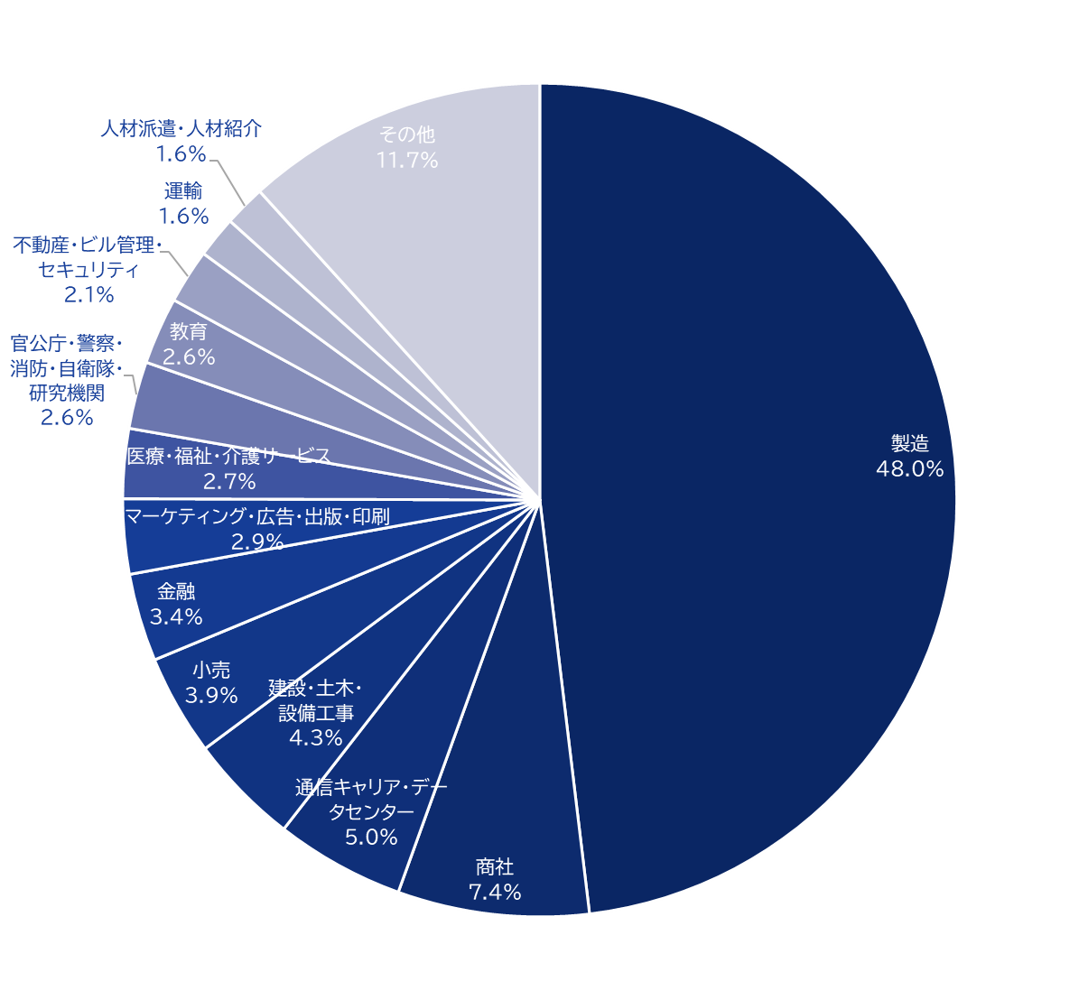
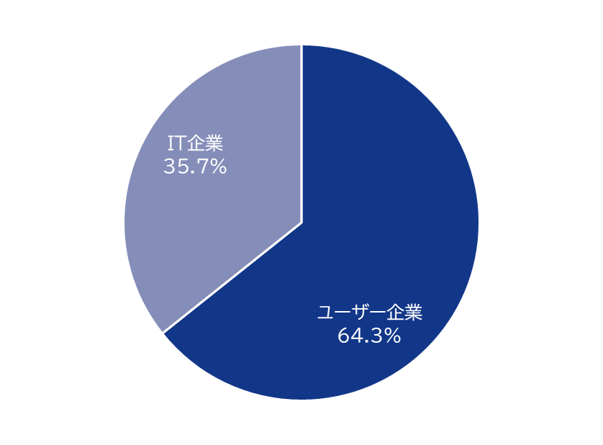
Majisemi's house list
Webinar
as a Service
Attraction power
Owning approximately 250,000
house list entries!
Breakdown of user companies
House
List
Overall
*Estimated from seminar applicants from 2020 to 2024
©2018 MAJISEMI Inc.

Slide 14
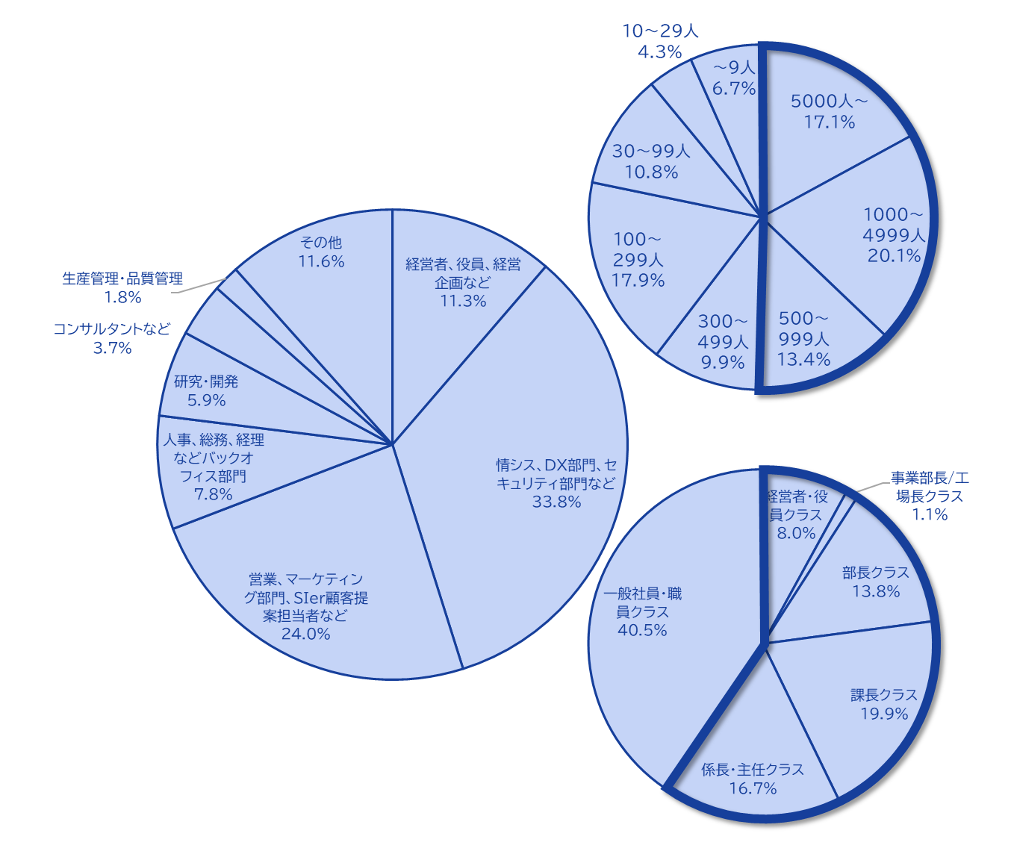
Majisemi's house list
Webinar
as a Service
The Majisemi list is
is almost exclusively focused on the following attributes.
Nearly half work at
Employed at large enterprises
Company
Size
All industries × Information systems departments, DX-related departments
All industries × Security departments
Manufacturing × Production and manufacturing departments
All industries × Back office departments
IT Companies × All Job Functions
Job function
House list breakdown
To attract participants who better match your products/services, Majisemi uses a theme-based approach (title, announcement text) for webinars instead of specifying attributes (segments) for mail-based customer attraction.
Webinar themes are set to
on behalf of Majisemi,
adopting a method that increases the proportion of your target audience.
Emails are not sent to all contacts, but prioritized for those highly interested in the set theme.
Position
Primarily managers
©2018 MAJISEMI Inc.

Slide 15





Why is it necessary to hold webinars?
Webinar
as a Service
The value of cold leads and the importance of repeating webinars
Lead acquisition
Nurturing and business negotiations
Contract
1 individual
Hot leads
3 participants
Seminar hosting
30 participants
Cold lead
21 individuals
Repeatedly held
It's important to do so!
27 individuals
By repeatedly holding webinars, including past participants,
to efficiently acquire new leads and nurture them.
If left unattended
21 individuals
80% sign contracts with
competitors within 2 years
Majisemi conducts long-term follow-ups with past participants,
and also offers 'Maji Follow Plus' to assist in appointment acquisition.
(SiriusDecisions survey)
©2018 MAJISEMI Inc.

Slide 16








Reasons to use Majisemi
Webinar
as a Service
Delegate your webinar operations to us
Repeat PDCA to explore winning patterns
Planning
Attracting attendees
Seminar
Secretariat
Moderation
Appointment acquisition
(Optional)
Survey aggregation
Report creation
SEO article creation
Video production
(Optional)
Review &
Improvement
With a one-stop service,
from start to finish
Majisemi handles it all, so
All support included
with only the cost of attracting attendees!
Focus on the presentation
on the day!
©2018 MAJISEMI Inc.

Slide 17

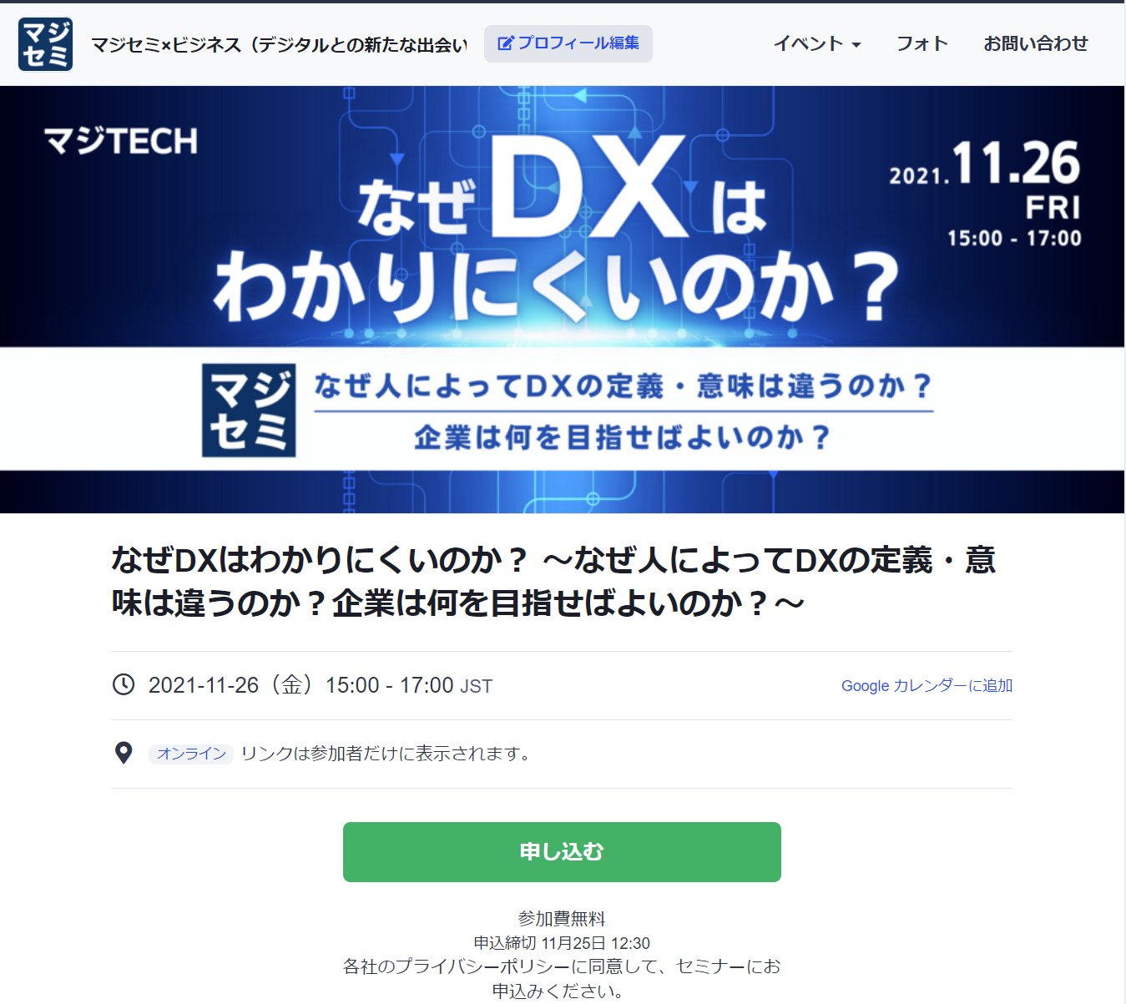
Reasons to use Majisemi
Webinar
as a Service
In a single webinar, it is possible to acquire new leads and nurture existing leads simultaneously
Audience acquisition page creation & publication
Attracting attendees
Majisemi management screen
Reminder distribution 1 week before & the day before
Majisemi audience acquisition slot
Attracting customers with Majisemi
Majisemi slot
Applicant data
Distribution of participation URL
Plan finalized
Applications to your customer acquisition slot
Applications are
not subject to charges, regardless of the number!
For nurturing your existing
house list nurturing,
reviving dormant customers,
and acquiring new leads through your website, etc.,
please make full use of this!
Your audience acquisition slot
After publication
We will provide
will be provided
Attract customers through your company's house list and website, etc.
Your audience acquisition slot
Applicant data
We will create a dedicated customer acquisition site URL for you
we will create a dedicated customer acquisition site URL for your company.
Delivery of all leads to your company
©2018 MAJISEMI Inc.
*Excludes disqualified applicants and those on the waiting list

Slide 18
Successful webinar case studies

Slide 19
(Case 1) "Changed the theme and achieved over 120 attendees" <Company C>
■ Customer's challenges
・Focus on server/infrastructure services, targeting SIer companies
・We are hosting webinars in-house but cannot attract attendees
・Even when we ask media to attract attendees, we fail to do so
■ Plan utilized
・Visitor (later transitioned to Majisemi Club)
■ Response by Majisemi
・Using know-how from hosting 1,000 webinars ann ually and tools such as 'trend analysis tool', Majisemi proposes 'attractive event planning'
■ Results
・Achieved attracting over 120 attendees
©2018 MAJISEMI Inc.

Slide 20
(Case 2) "While exploring themes, achieved over 50% appointment acquisition" <Company T>
■ Customer's challenges
・Tool vendors
・Focused on marketing through exhibitions, but struggled to convert to business discussions
■ Plan utilized
・Visitor (later transitioned to Majisemi Club)
■ Response by Majisemi
・While repeatedly hosting webinars, searched for themes that 'att ract a good number of attendees and lead to business discussions'
■ Results
・Consistently attracted around 30 attendees, improving conversion rate from 10%→20%→50%
・Presenters themselves conducted follow-up after webinars
©2018 MAJISEMI Inc.

Slide 21
(Case Study 3) "Switched to online and acquired 20% appointments" <Company Z>
■ Customer's challenges
・Global IT company developing and selling package products and SaaS
・Hosting offline seminars but struggling with attracting attendees and attendance rates
・Does not lead to business discussions
■ Plan utilized
・Visitor
■ Response by Majisemi
・Proposal for online (webinar)
・Implemented 'seminar planning that leads to business discussions'
■ Results
・30 registrations → realized 6 appointments
©2018 MAJISEMI Inc.
‹#›

Slide 22
(Case Study 4) 'Acquired over 15% appointments with follow-up outsourcing' <Company I>
■ Customer's challenges
・Infrastructure IT venture company developing its own products
・Hosted several webinars with good attendance but no conversion to business discussions
・Busy representatives unable to adequately follow up after webinars
■ Plan utilized
・Visitor
■ Response by Majisemi
・Implemented 'seminar planning that leads to business discussions'
・Implemented follow-up service 'MajiFollow' to make calls right after webinars
■ Results
・50 registrations → realized 8 appointments
©2018 MAJISEMI Inc.

Slide 23
(Case Study 5) "AI presented and acquired 20% appointments" <Company A>
■ Customer's challenges
・Foreign SaaS vendor
・Achieving attendance targets every time but not leading to business discussions
・Issues with presentation materials and content
■ Plan utilized
・Majisemi Club
■ Response by Majisemi
・Implemented creation of presentation scripts by generative AI and presentation delegation by AI digital human
・Implemented follow-up service 'MajiFollow' to make calls right after webinars
■ Results
・20 registrations → realized 4 appointments
©2018 MAJISEMI Inc.

Slide 24
About plans and pricing
©2018 MAJISEMI Inc.

Slide 25
Plan Comparison
Pricing Plans
Recommended
 | Visitor | Majisemi Club Light | Majisemi Club Business Negotiation Guarantee
Recommended for these individuals! | Planning to hold webinars 1 to 2 times a year | Planning to hold webinars 4 times or more annually Want to reduce cost per lead | Want business negotiations (appointments) rather than just attracting attendees Want a guarantee
Cost per lead comparison | 14,500 JPY | 12,000 JPY (10 people monthly) 10,000 JPY (for additional attendees) | 20,000 JPY (30 people over 3 months) 13,500 JPY (for additional attendees)
Not subject to duplicate charges for past applicants ※Refer to each plan's description for details | None | Available | Available
Business discussion (appointment) guarantee ※Refer to each plan's description for details | None | None | Available
Contract period | Per session | Monthly (Auto-renewal) | Every 3 months (Auto-renewal)
©2018 MAJISEMI Inc.

Slide 26
Are there any services outside the basic plan that you are interested in?
Service Map
Limited slots
First-come, first-served
Exhibition
Joint exhibition
Your company-owned leads
(Not subject to charges)
Webinar hosting
Lead follow-up, proposal, and order
Recommended
New service
Presentation script/materials
Creation outsourcing
AI presentation delegation
Webinar hosting
(Visitor or Majisemi Club)
Post-webina r follow-up
(Maji Follow)
Sales outsourcing
(Proposal and order)
(Maji Sales)
Your company inside sales
Or fiel d sales
Recommended
New service
Many companies
Will be utilized
Missed
Broadcast
Rebroadcast
2-step
Webinar
Many companies
Will be utilized
Utilization of webinar content
Many companies
Will be utilized
Many companies
Will be utilized
Recommended
New service
SEO article
Creation
Full video
Provided/Free
Full video
Provided/Secondary use
Summary
Video production
SEO video creation
©2018 MAJISEMI Inc.

Slide 27
Majisemi Club or visitor?

Slide 28

Plan Comparison
Pricing Plans
Visitor
Seminar hosting 30 attendees achieved
Majisemi Club
Seminar hosting 30 attendees achieved
(Monthly membership fee)
10 additional people per month
10 people × @12,000 JPY
Attendance slots
10 people
Utilize free benefits for 20 people
Attendance slots
20 people
Billing
30 people × 14,500 JPY = 435,000 JPY (tax excluded)
Billing
10 people × 12,000 JPY = 120,000 JPY (tax excluded)

Slide 29
Majisemi Club Initial 20 People Free Benefit
Campaign
By contracting Majisemi Club, you can use this benefit at the time of your first event.
You can cancel at any time. Even if you cancel after one session, it is more advantageous than being a visitor.
Image of hosting using special offers
 | January | February | March | April
Membership Fee Billing Amount | 120,000 yen | 120,000 yen | 120,000 yen | 120,000 yen
Additional attendance slots | +10 people | +10 people | +10 people | +10 people
Campaign-Based Additional attendance slots (free) | +20 people | - | - | -
Remaining Attendance Slots | 30 participants | 10 people | 20 people | 30 participants
Seminar hosting | 30 participants | - | - | 30 participants
You can purchase additional audience slots at any time
(at a cost-effective 10,000 yen each) to
allowing additional webinars to be hosted
First 20 participants free
Immediately host a webinar for up to 30 participants
Webinar hosting available
If hosting only once for the first time and canceling at the end of March (notification by the end of February),
Only the membership fee of 120,000 yen x 3 months will be charged.
©2018 MAJISEMI Inc.

Slide 30
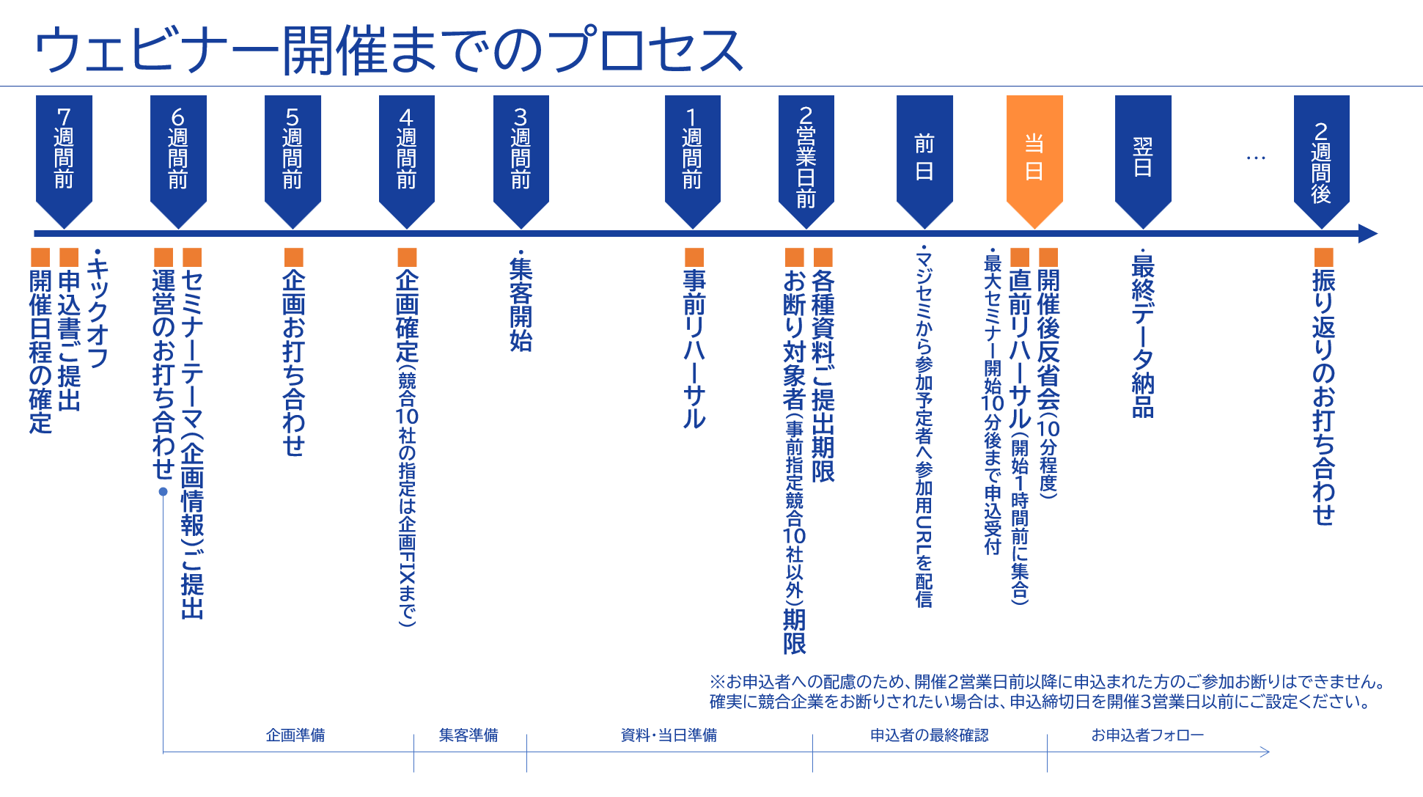
©2018 MAJISEMI Inc.

Slide 31
Take this opportunity to start with Majisemi!
Clients using Majisemi have shared feedback such as
The audience turnout is good,
and it leads to business negotiations.
Awareness has increased, and inquiries from the web
have also increased.
The staff (attendants and cast) were excellent,
making it easier to host seminars.
We have received comments like these.
And most client companies repeatedly host seminars with Majisemi.
However, you might have the following concerns.
"Will the target companies really attend?"
"How much easier will the operation become?"
For such customers,
we offer the 'Majisemi Club Membership First 20 Participants Free' campaign.
Please try Majisemi!
©2018 MAJISEMI Inc.

Slide 32
~Please check later~
(For your reference) Other information

Slide 33


Reasons to use Majisemi
Webinar
as a Service
Delegate your webinar operations to us
A dedicated planning manager will create the title and announcement text!
Planning
A Majisemi planning specialist with IT knowledge will collaborate with you to create a webinar plan that achieves audience acquisition and business negotiations.
STEP1
STEP2
STEP3
Official application
Enter product name, product information, target, and pain points into the management system.
Planning meeting
We will conduct a one-hour meeting online.
We will align details based on the preliminary information.
Plan finalized
Press the approval button on the management system to finalize the plan.
Our company
Attraction page
Publication preparation
Start!!
Confirm by email
Preparation for
Attendants (seminar secretariat) will support you until the webinar is hosted!
Attendant
(Seminar secretariat)
An attendant with experience in managing 1,000 seminars annually will accompany you until the seminar is held.
Feel free to consult us with any issues!
STEP4
STEP 5
STEP6
On the day
・Moderation
- Collect surveys
Publication of the recruitment page
Creation of the application page
Handling of applicants
- Respond to inqu iries - Reminders
- Issue participant URL
Rehearsal
- Confirm the day's flow and request s - Check speakers' connection envir onment - Confirm preparation status
Report creation
Cast
Cast
©2018 MAJISEMI Inc.

Slide 34
Reasons to use Majisemi
Webinar
as a Service
Dedicated support from the planning stage
Planning stage flow
Preliminary preparation
The planning manager will gather information on the seminar theme shared in advance and create promotional angle proposals.
Planning meeting
Conduct a meeting of about one hour. We will propose promotional angles and align details.
Create proposal
Based on the content aligned in the meeting, the planning manager will create a draft of the title and announcement text.
Submit proposal
After creating the proposal, the planning manager will submit it via email.
Confirm proposal content
Please confirm the proposal content and share any feedback.
Finalize proposal
Once you have confirmed the content and revisions are complete, press the approval button on the management system to finalize the plan.
Attraction page
Start preparation for publication
©2018 MAJISEMI Inc.

Slide 35
Flow of the event
On the day of the event
Webinar
as a Service
Event time
Distribution tools
General flow of the seminar
Choose from 5 slots
(Weekdays only *No weekends or holidays)
The basic duration for one seminar is 1 hour
You can choose from 2 types
*We recommend Zoom for its functionality and delivery quality
*For seminars hosted by Majisemi, an additional fee is charged for events longer than 1 hour (150,000 yen/hour)
10:00-11:00
Registration starts
15 minutes
11:00-12:00
Opening
(Majisemi Cast)
Zoom
Teams
13:00-14:00
5 minutes
Presentation
14:00-15:00
30-40 minutes
Poll
3:00 PM - 4:00 PM
Q&A
(Navigated by Majisemi Cast)
* On Mondays, only the 2:00 PM and 3:00 PM sessions are available
* Majifolo is only conducted at the 10:00 AM and 11:00 AM sessions
*For seminars targeting the manufacturing industry, to avoid theme overlap, they are scheduled at 11:00 AM and 1:00 PM
10-15 minutes
End
©2018 MAJISEMI Inc.

Slide 36
Reasons to use Majisemi
Webinar
as a Service
Effective use of content
Branding & new lead acquisition
Create articles from presentation content
Register on your own site, also for SEO measures
SEO article
Create (blog)
During webinar hosting
Reuse content to
Continue lead nurturin g and acquire new lea ds even after hosting
Distributed later exclusively to absentees
Rebroadcast past Majisemi event videos
Effortless event without on-the-day presentation
Webinar Hosting
Missed session streaming
Rebroadcast
Recorded video
Uploaded to your own website or YouTube
Summary vid eo creation
On your own website or
Post on your company-managed social media
Webinars or videos not hosted by Majisemi
Secondary use on portals and advertising media
Full vide o provided/free*
Full video p rovided/secondary use*
Lead nurturing
Listed on majisemi.com
Acquire new leads
Majisemi Club Benefits
※In the trial, we do not provide full videos regardless of free or paid. However , after the main contract, past sessions can be provided regardless of the plan.
Maji Lead
Document download
©2018 MAJISEMI Inc.

Slide 37
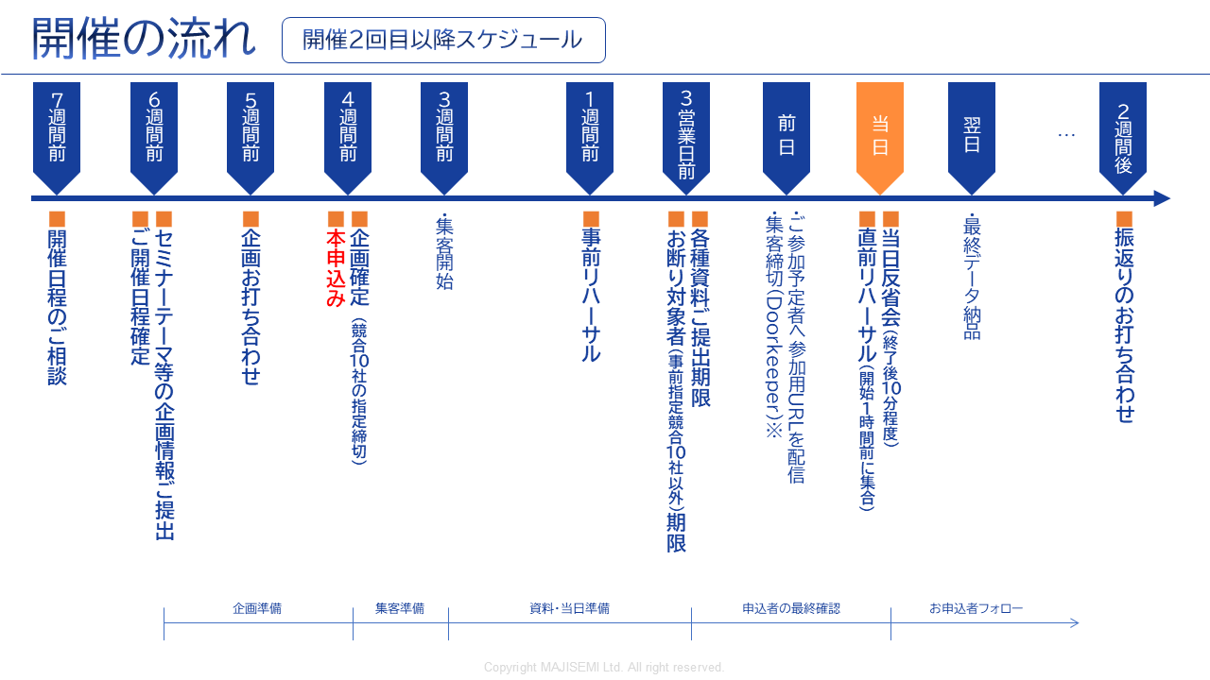
Webinar
as a Service
※To accommodate applicants, we cannot decline participation for those who apply within 2 business days before the event.
If you want to ensure competitors are excluded, set the application deadline 3 business days prior.
©2018-2024 MAJISEMI Inc.
©2018 MAJISEMI Inc.

Slide 38
Basic Plan
Majisemi Visitor
Plan details
Reference plan
Pricing Plans
This is a completely performance-based plan for holding a standalone webinar.
Choose from four types depending on how much you wish to delegate.
Accepted for applications from 20 people.
If there are only 10 applicants, you will only be charged for 10 people.
14,500 yen per application (excluding tax)
- Hold and apply as needed
- Performance-based fee according to the number of attendees
- Application from more than 20 people
(Billing is only for the number of attendees)
*To accurately track the number of attendees, we will prepare the application page and provide the list to your company.
*The actual billing will be based on the number of applicants, up to the maximum number mentioned above. If full, application reception will stop.
*For privacy reasons, the list will be delivered directly to the seminar organizer.
*Billing applies to not just participants but also absentees (pre-day cancellations, on-the-day cancellations).
*We will strive to gather attendees close to the maximum but cannot guarantee the number of attendees.
*Due to the seminar theme or other simultaneous events, there may be cases where no attendees are gathered.
Operation
Operation
Menu |  | Planning | Attracting attendees LP setup | Moderator | Other media Integration | URL delivery Reminder | Zoom Provision | Post-event Survey
Majisemi Visitor | Standard | ○ | ○ | ○ | No listing on other media | ○ | ○ | ○
 | Planning and promotion | ○ | ○ | - |  | - | - | -
 | Promotion and operation | - | ○ | ○ | - | ○ | ○ | ○
 | Promotion only | - | ○ | - | - | - | - | -
Product name | Content | Quantity | Unit price (¥) | Amount (¥)
Majisemi Visitor (20 people)) | Webinar Planning, promotion, and operation | 20 | 14,500 | 290,000
Visitor plan Reference plan for 20 people |  | Subtotal |  | 290,000
 |  | Consumption tax (10%) |  | 29,000
 |  | Total (including tax) |  | 319,000
©2018 MAJISEMI Inc.

Slide 39
Basic Plan
Majisemi Club Light
Plan details
Reference plan
Pricing Plans
Monthly fee: ¥120,000 (excluding tax) *With the light plan, includes 10 promotion slots
Additional promotion slots @¥10,000 (excluding tax)
Automatic renewal every month
Add 10 promotion slots every month
The minimum capacity for a webinar is 30 people
If holding a 30-person webinar in the first month, purchase 20 additional promotion slots (@¥10,000)
If the number of attendees does not reach capacity, the remaining slots can be carried over to subsequent months.
Additional attendance slots can be purchased at ¥10,000 each.
If someone who has registered for at least one of the last three seminars you hosted (subject to charges) registers again for the current seminar, that seminar will not be subject to charges (fan development).
Other benefits include providing leads from those who download publicly available presentation materials, a branding dashboard, and a trend analysis tool.
Majisemi Club is a membership service that continuously runs webinars, applying PDCA to create better webinars. Membership is subject to screening.
For Majisemi Club, we offer a one-stop service including planning, promotion, hosting, and operation. We do not provide support for promotion only.
Also, the content (planning) of the seminar will be "problem-solving seminar" instead of "product introduction". The product introduction will be done in the latter half of the presentation. The seminar content will be decided in consultation with the Majisemi planning team. It may not be possible to hold it on the theme your company desires. If you wish to decide the theme yourself, please use the Visitor plan.
In light of the aforementioned purpose of Majisemi Club, please note that there is a penalty for cancellation within one year of the contract start. (The difference from the Visitor fee will be charged)
*To accurately track the number of attendees, we will prepare the application page and provide the list to your company.
* If the capacity is reached, applications will be stopped.
*For privacy reasons, the list will be delivered directly to the seminar organizer.
* Not only participants but also absentees (pre-cancellations, same-day cancellations) are counted in the number of attendees.
* The contract is automatically renewed every month and will continue as such.
* In case of withdrawal, unused promotion slots cannot be refunded. Additionally, you cannot rejoin Majisemi Club for one year after withdrawal.
* For withdrawal, please contact us via email by the end of the month prior to the withdrawal month.
* Benefits are subject to change.
For those who have challenges in turning post-seminar discussions into business or wish to strengthen their own website content and SEO, please consider our value set plan mentioned later.
Product name | Content | Category | Amount (¥)
Majisemi Club Light (30 participants) | Webinar planning, attracting attendees, and management | Monthly fee | 120,000
Majisemi Club Light Plan Attracting 30 attendees, If you attract 10 attendees through the monthly membership and 20 through additional attendance |  | Additional participant slots | 200,000
 |  | Consumption tax (10%) | 32,000
 |  | Total (including tax) | 352,000
©2018 MAJISEMI Inc.

Slide 40
Basic Plan
Majisemi Club Light
billing pattern
Pricing Plans
Example of hosting a webinar and billing with Majisemi Club
Add 10 attendees every month
Webinar
Held
Webinar
Held
Webinar
Held
seminars can be held anytime (or not at all)
(The target capacity is 30 or more attendees, and 10 or more for replays)
Webinar
Held
 | January | February | March | April | May | June | July | August | September | October | November
Additional attendance slots | +10 | +10 | +10 | +10 | +10 | +10 | +10 | +10 | +10 | +10 | +10
Beginning of the month Remaining Attendance Slots | 10 | 10 | 20 | 30 | 15 | 10 | 20 | 30 | 40 | 50 | 10
Monthly fee billing | 120,000 yen | 120,000 yen | 120,000 yen | 120,000 yen | 120,000 yen | 120,000 yen | 120,000 yen | 120,000 yen | 120,000 yen | 120,000 yen | 120,000 yen
Seminar hosting Target capacity | 30 participants |  |  | 30 participants | 50 participants |  |  |  |  | 50 participants
Seminar hosting Attraction results | 30 participants |  |  | 25 participants | 48 participants |  |  |  |  | 50 participants
Consumption of attendance slots | -10 |  |  | -25 | -15 |  |  |  |  | -50
End of the month Remaining Attendance Slots | 0 | 10 | 20 | 5 | 0 | 10 | 20 | 30 | 40 | 0 | 10
Additional participant slots | 20 |  |  |  | 33
Additional participant slots billing | ¥200,000 |  |  |  | ¥330,000
The target capacity is 30 or more attendees
Holding events with 50, 100 attendees, etc. is also acceptable
It's fine to have a seminar with 30 attendees from the first month
carry over any shortfall to the next month
Shortfalls will be billed at ¥10,000 each
There will be no more attendees than the target capacity
©2018 MAJISEMI Inc.

Slide 41

Basic Plan
Majisemi Club Business Negotiation Guarantee
Plan details
Reference plan
Pricing Plans
¥600,000 every 3 months (excluding tax)
Automatically renewed contract every 3 months
Guarantees 30 attendees and 3 business meetings every 3 months
Majifolo is provided free of charge
If unmet, the unmet portion will be carried over to the next seminar
If more than 31 additional people are hosted, the registration fee is 13,500 JPY per person
If someone who has registered for at least one of the last three seminars you hosted (subject to charges) registers again for the current seminar, that seminar will not be subject to charges (fan development).
Other benefits include providing leads from those who download publicly available presentation materials, a branding dashboard, and a trend analysis tool.
This is an automatically renewed plan every 3 months. It guarantees 30 attendees and 3 business meetings (appointments).
Our company will handle everything from planning the seminar content, attracting attendees, managing the day, to sending materials to attendees on the day.
Majifolo is included in the fee.
If the initial seminar does not meet 30 attendees or 3 appointments, it will either be carried over to that quarter or the next quarter,
or we will hold an additional seminar. (The basic goal is to achieve this in the initial seminar)
※To accurately track the number of attendees, we will prepare the registration page and provide the list to your company.
※We will stop accepting applications once the capacity is reached.
*For privacy reasons, the list will be delivered directly to the seminar organizer.
* Not only participants but also absentees (pre-cancellations, same-day cancellations) are counted in the number of attendees.
※The contract is automatically renewed every 3 months and will continue similarly thereafter.
* In case of withdrawal, unused promotion slots cannot be refunded. Additionally, you cannot rejoin Majisemi Club for one year after withdrawal.
※Please notify us via email by the end of the month prior to the month of withdrawal if you wish to withdraw.
※We may not be able to offer guarantees related to business discussions.
* Benefits are subject to change.
Product name | Content | Quantity | Unit price (¥) | Amount (¥)
Majisemi Club event (30 participants) | Webinar planning, attracting attendees, and management | 1 | 600,000 | 600,000
Majifolo (30 participants) | Appointment setting via phone and email for participants | 30 | 3,500 | 105,000
 | With Majisemi Club's guaranteed business discussion, all cases are free | 30 | -3,500 | -105,000
Majisemi Club Guaranteed Business Discussion Plan Reference plan for 30 participants |  | Subtotal |  | 600,000
 |  | Consumption tax (10%) |  | 60,000
 |  | Total (including tax) |  | 660,000
Guaranteed customer acquisition and business discussions!
©2018-2023 MAJISEMI Inc.

Slide 42
Majisemi Club's value plans (planned revisions)
Pricing Plans
Recommended
 |  | Light | Silver | Gold | Platinum | Premium
Additional services | Webinar hosting | ● | ● | ● | ● | ●
 | SEO article creation | ― | ●※1 | ― | ― | ●※1
 | Majifollow | ― | ― | ●※2 | ●※2 | ●※2
 | Majifollow Plus | ― | ― | ― | ●※3 | ●※3
 | Summary video | ― | ― | ― | ― | ●※1
Bonus slots for additional customer acquisition (Bonus)※4 |  | ― | 10 slots annually Equivalent to 100,000 JPY | 20 slots annually Equivalent to 200,000 JPY | 40 slots annually Equivalent to 400,000 JPY | 80 slots annually Equivalent to 800,000 JPY
Monthly fee |  | 120,000 yen | 135,000 JPY | 155,000 JPY | 255,000 JPY | 385,000 JPY
Simply webinars
Only want to request hosting
Want to utilize the presentation content
Also on the website
Want to follow up
Immediately after the webinar
ウェビナーから確実に
商談につなげたい
ウェビナーの効果を
最大化したい
※1 SEO article creation and summary video creation can be conducted up to four times a year. Additional options can be purchased for further implementation.
※2 Majifollow can be conducted for up to 120 people annually. Additional options can be purchased for further implementation.
※3 Includes monthly activity costs for Majifollow Plus. An additional performance fee of 30,000 JPY per appointment applies.
※4 The bonus slots for additional customer acquisition will be granted one year after joining the Majisemi Club and every year in the same month thereafter.
(All amounts are tax-exclusive)
©2018 MAJISEMI Inc.

Slide 43
その他のオプション ※詳細は個別にご相談ください
Webinar
as a Service
Name | Price (excluding tax) | Content
Majifollow (Post-seminar follow-up) | @3,500円×集客人数 | マジセミのフォロー専門スタッフが、セミナー終了直後に参加者、欠席者に対して、メール、電話でフォローします。
SEO article creation | 5万円 | セミナーの講演内容から、SEOを意識した3,000字程度の記事を作成します。貴社のWebサイトに掲載することで、コンテンツマーケティングを促進します。
Full video provision/paid | ¥200,000 | セミナー動画をご提供させていただき、２次利用していただくためのオプションです。 ※一定の利用制限内であれば無料でご提供いたします。トライアル時は、有料、無料ともご提供はありません。
Summary video creation | 5万円 | セミナー動画をYoutube等に掲載する場合、長時間の動画は嫌われる傾向があります。このため5～10分程度に編集してご提供いたします。
Missed session streaming | 5万円 | セミナー申込者の内、当日欠席された方に対して、当日の動画を視聴していただきます。
Rebroadcast | @14,500円/10,000円 | 過去マジセミで開催した録画を使って、手間なく追加のウェビナーを開催します。
Two-step webinar | ２０万円 | 過去に貴社のウェビナーにお申し込みいただいた方（貴社の見込み客）に対して、より商談（アポ）につながるテーマ（他社比較、製品紹介、デモなど）を企画し、開催します。
Operational support (operation outsourcing) | ２０万円 | 貴社セミナーの運営を代行します。申込みページの作成、申込者の管理、Zoomの貸出、当日の司会進行、など一連の作業を代行します。（集客は含まれません。貴社にて集客していただきます。）
マジセミ代表 寺田による Presentation at your seminar | 30万円～ ※30分～1時間程度 | マジセミ代表 寺田が、貴社セミナーでのプレゼンや対談、パネルディスカッションのファシリテーターを行います。テーマはご相談ください。
“エバンジェリストAI”デジタル寺田による基調講演代行 | 10万円 | 生成AIを活用した“エバンジェリストAI”デジタル寺田が、貴社のウェビナーで基調講演を行います。 - Want to give a seminar presentation but don't have time to create the script and slides - No skilled presenters among employees (or they are too busy), so want to outsource the presentation as well
SEO video creation | 1本5万円～ ※10本単位、初期費用別 | Youtubeの検索や、Googleの動画検索で上位表示を狙うための施策です。マジセミが貴社専用のAIアバターを作成、用語解説の動画コンテンツを作成します。原稿も納品、ブログ活用も可能です。
Product comparison video creation | 50万円～ ※初期費用別 | 貴社の製品の強みを強力に認知させるための競合製品比較動画を作成します。マジセミが貴社専用のAIアバターを作成、製品比較動画コンテンツを作成します。ウェビナーでの配信も可能です。
©2018 MAJISEMI Inc.

Slide 44
Notes
Webinar
as a Service
■ In principle, meetings start 6 weeks in advance, with final orders placed 4 weeks before the event.
Additional charges
キャンセル料金
全てのサービスにおいて、マジカン（マジセミ管理画面）から「本申込」をしていただいた後、又は発注書・申込書を受領した後にキャンセルされた場合、100%のキャンセル料金が発生します。
但し、ウェビナー開催については、ビジターは20名分のキャンセル料金、マジセミ倶楽部においては30名分の集客枠の消費を上限とします。
マジフォロについては、ビジターの場合は20名分、マジセミ倶楽部の場合は30名分のキャンセル料金を上限とします。
ウェビナー開催において、タイトル、告知文などの調整が遅れて、ウェビナーの公開が開催日の１０営業日前の17時までに行えなかった場合、キャンセルの扱いとし上記キャンセル料金をご請求いたします。
マジセミ倶楽部の退会時、集客枠残について返金できません。
マジセミ倶楽部の主旨を鑑み、マジセミ倶楽部の契約開始から１年以内の解約の場合、ペナルティを設定させていただいております。ご了承ください。（ビジターの料金との差額をご請求いたします）
Majisemi Visitor
開催4週間前を過ぎての発注は、料金が割り増しになります。
 | Unit price (excluding tax) | 上限指定
Basic fee (Order placed more than 4 weeks before the event) | 14,500 JPY | 20 or more people
Orders placed less than 4 weeks before the event | 1.25x surcharge
Orders placed less than 3 weeks before the event | 2x surcharge
Various Majisemi Club
If the final order cannot be placed 4 weeks before the event, there is no surcharge, but we will postpone the event upon consultation.
©2018 MAJISEMI Inc.

Slide 45
Majisemi Corporation

Slide 46

Company name
Headquarters location
Representative
Business activities
Seminar achievements
Established
Capital
Number of employees
Majisemi Corporation
3rd Floor, Shiodome Building, 1-2-20 Kaiga n, Minato-ku, Tokyo 105-0022 Yuichi Terada
Operation of the IT and manufacturing industry-focused seminar marketing service "Majisemi"
Last year's achievement: Approximately 1,000 events held, with a total attendance of about 60,000 people (2023)
January 2018
10 million JPY
45 employees
About Us
Company overview
Creating opportunities for new encounters and experiences w ith digital products and services to promote the development of domestic industries and the advancement of engineers.
To achieve this, we communicate superior technologies and their potential to society, regardless of the size of the providing company.
We clearly convey to end users not the technology itself, but how it can solve their problems.
By 2025, we aim to host 2,000 webinars annually.
MISSION
Transform seminars into entertainment
Change society through seminars
Thanks to you, we achieved three No.1
achieved! 1
No.1 in seminars strong in attracting customers
Seminars chosen by
IT managers
No.1
For acquiring new business negotiations
Seminars strong in
No.1
©2018 MAJISEMI Inc.
Survey overview by Japan Marketing Research Organization: 2021 service comparison impression survey

Slide 47
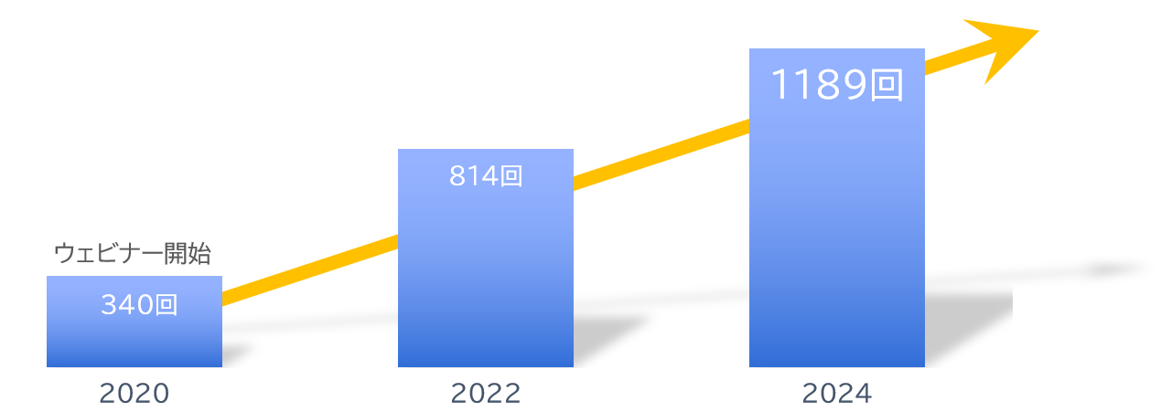
About Us
With our clients
Number of seminars held
Increasing every year!
A10 Networks, Inc.
ITec Hankyu Hanshin Co., Ltd.
Advantech Co., Ltd.
AXIO Corporation
Assist Corporation
ITOCHU Techno-Solutions Corporation
Internet Initiative Japan Inc.
Infocom Corporation
Equinix Japan K.K.
SCSK Corporation
F-Secure Corporation
MOTEX Inc.
Encourage Technologies Co., Ltd.
Entrust Japan Co., Ltd.
OGIS-RI Co., Ltd.
OPRO Co., Ltd.
QlikTech Japan K.K.
Cross Head Co., Ltd.
KCCS Mobile Engineering Co., Ltd.
Serverworks Co., Ltd.
Sios Technology, Inc.
Cybertrust Japan Co., Ltd.
ZEAL Corporation
CTC System Management Corporation
Systena Corporation
Singapore Telecommunications Japan Co., Ltd.
GMO GlobalSign K.K.
JB Service Co., Ltd.
Startia Raise, Inc.
Smart Style Co., Ltd.
Sumitomo Electric Information Systems Co., Ltd.
Zoho Japan Corporation
Soliton Systems K.K.
Dynatrace
TIS Inc.
Techvan Co., Ltd.
TechMatrix Corporation
Delivery Consulting Inc.
Dell EMC
NSW Inc.
Hulinks Inc.
Netskope Japan Co., Ltd.
Pasona Tech, Inc.
Nippon Telegraph and Telephone East Corporation
Fujitsu Limited
Fujitsu Communication Services Limited
Fuji Electric IT Solutions Co., Ltd.
Mitsubishi Electric Information Systems Corporation
Mirantis Japan Corporation
Monstar Lab, Inc.
Red Team Technologies Co., Ltd.
Rosetta Corporation
(Agent)
MM Research Institute, Ltd.
Creative Bank Inc.
Target Media Co., Ltd.
Nikkei Advertising Inc.
Bigbeat Inc.
Mynavi Corporation
Transaction record
Major clients only, in alphabetical order
©2018 MAJISEMI Inc.

Slide 48
No.1 in seminars strong in attracting customers
No.1 in acquiring new business opportunities through seminars
No.1 seminar chosen by IT managers
Survey by Japan Marketing Research Organization Overview: 2021 Service Comparison Impression Survey
Transform seminars into entertainment
Change society through seminars

